Slide 1
Chapter 6: Multiple Antennas and Space-Time Communications

Slide 2
Introduction
MIMO System Model
MIMO Channel Capacity
Diversity and Multiplexing Tradeoff
Space-time modulation and coding

Slide 3
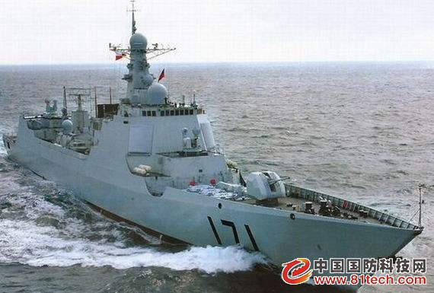
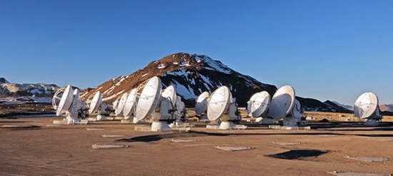
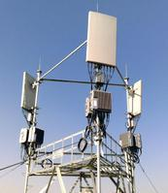
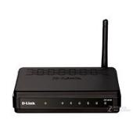
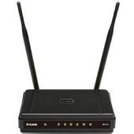
Some examples

Slide 4
MIMO features
A MIMO system has two basic features:
  Diversity (increase transmission reliability)
  Spatial multiplexing (increase data rates)
Research in MIMO
  Increasing the capacity of MIMO systems
  Developing systems that can operate close to the capacity
  Practical implementation with acceptable complexity
Primary applications
  3GPP LTE/LTE-A systems
  High capacity LANs ( 802.11…)

Slide 5

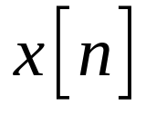
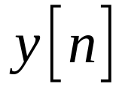
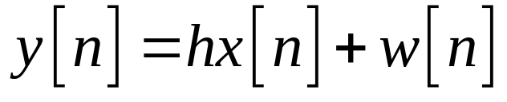
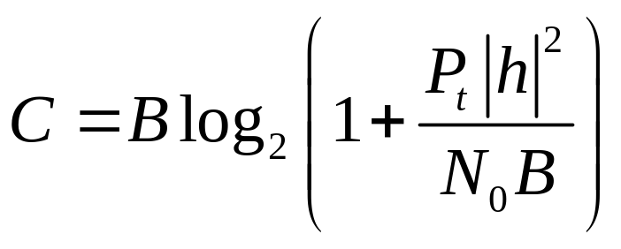
Single Input and Single Output (SISO)
Basic system model
The capacity of AWGN SISO channel

Slide 6






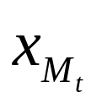
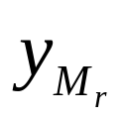
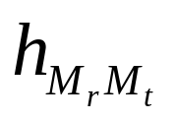
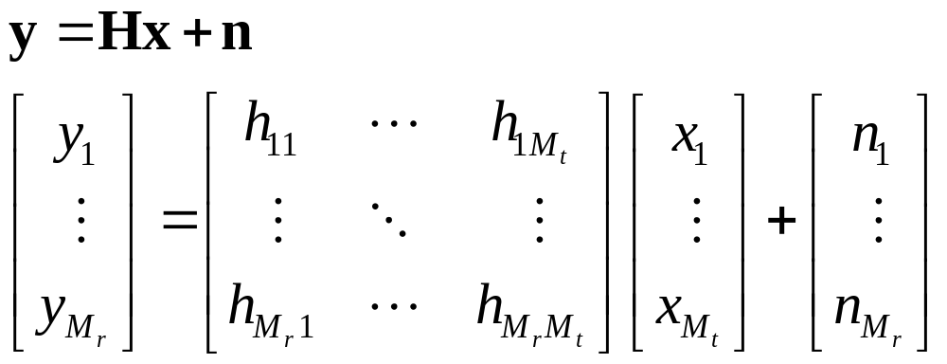
Narrowband MIMO model

Slide 7

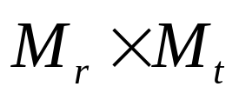
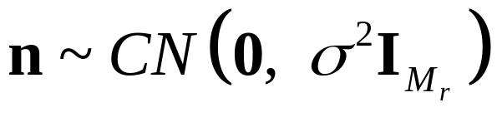
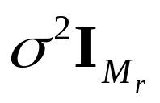
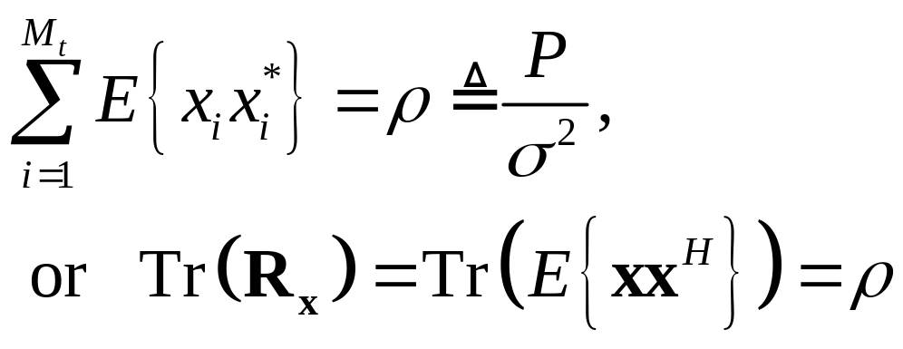

Some definitions in the system model
The size of channel matrix is .
The noise vector is complex circular symmetric Gaussian with zero mean and covariance matrix .
Power constraint
  is the average SNR per receive antenna under unity channel gain.

Slide 8
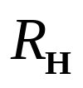
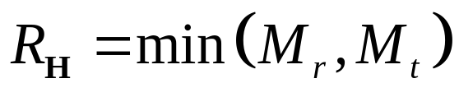
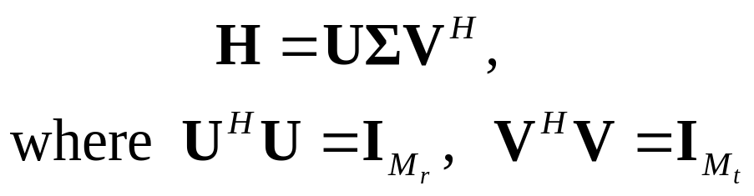
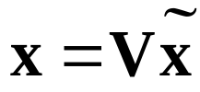


Parallel decomposition of the MIMO channel
Denote the rank of the channel as , in rich scattering environment, .
Using singular value decomposition (SVD), decompose the MIMO channel as
Through transmit precoding and receiver shaping ,
the MIMO channel can be convert to independent parallel channels with gain ( the i-th singular value of H) and AWGN.

Slide 9
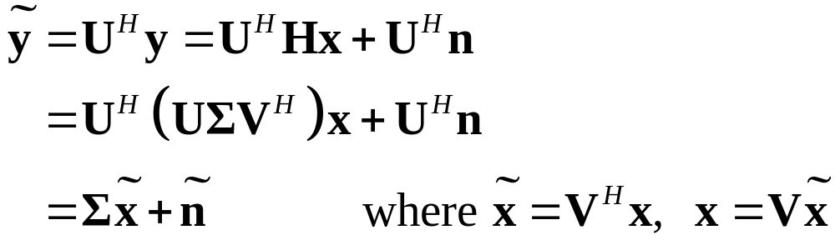












Diagonalization of MIMO Channels
Diagonalize the channel such that

Slide 10
Capacity of MIMO systems
Depends on what is known at TX and RX and if channel is static or fading
For static channel with perfect CSI at TX and RX, power water-filling over space is optimal:
  In fading water-fill over space (based on short-term power constraint) or space-time (long-term constraint)
Without transmitter channel knowledge, capacity metric is based on an outage probability
  P_{out} is the probability that the channel capacity given the channel realization is below the transmission rate.

Slide 11
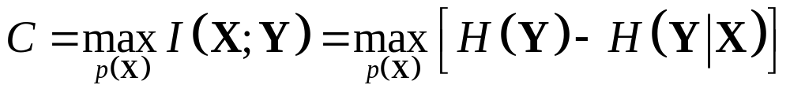

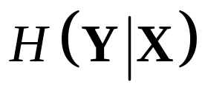
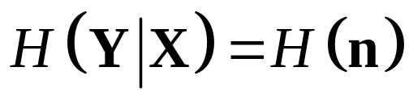

Capacity of static MIMO channels
For static channels, assume CSIR, the capacity in terms of mutual information
Given the input signal , the conditional entropy depends only on the uncertainty of noise
The target is to maximize the entropy of .

Slide 12
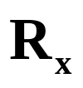
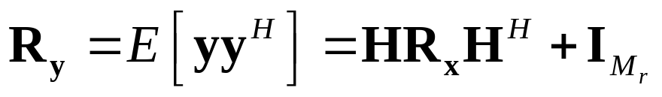


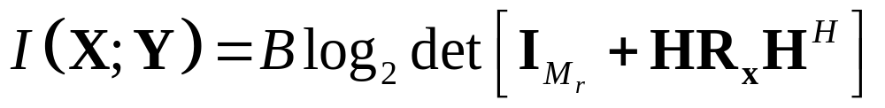
Capacity derivation
Define the covariance matrix of the input signal as , then the covariance matrix of the output signal is
The entropy is maximized when is zero-mean, circularly symmetric complex Gaussian (ZMCSCG) random vector.
Only if is ZMCSCG, the resulting mutual information

Slide 13
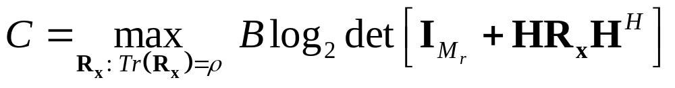
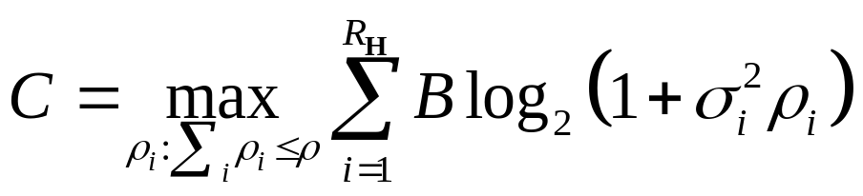
Case of CSIT
MIMO capacity is given by
It can be found that
is the degree freedom of the MIMO channel.

Slide 14
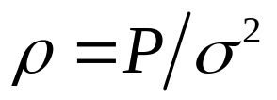
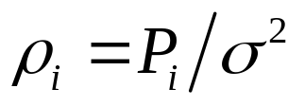
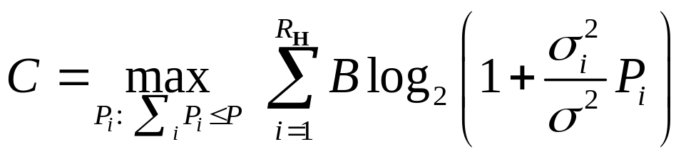
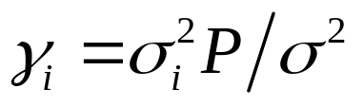
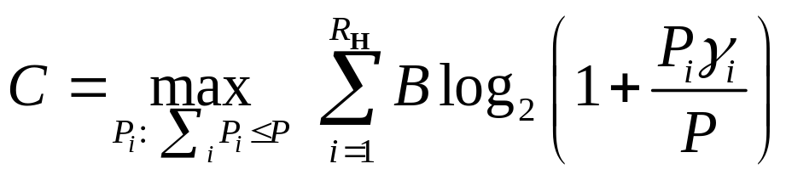
Water filling
Remember the definition of .
Define for each channel
The capacity is then
Define for each channel is the SNR associated with the i-th channel at full power, then
Do water filling among parallel channels

Slide 15
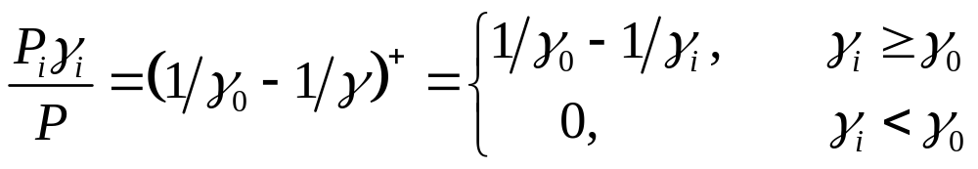

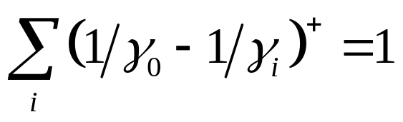
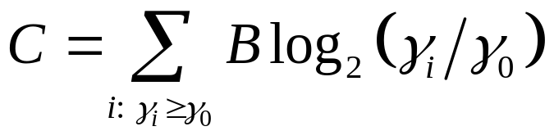
Optimal power allocation
Power allocation problem
Optimal solution
With the value derived from
The capacity is then

Slide 16
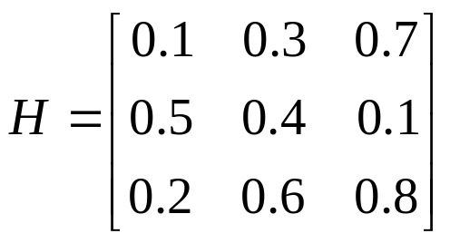
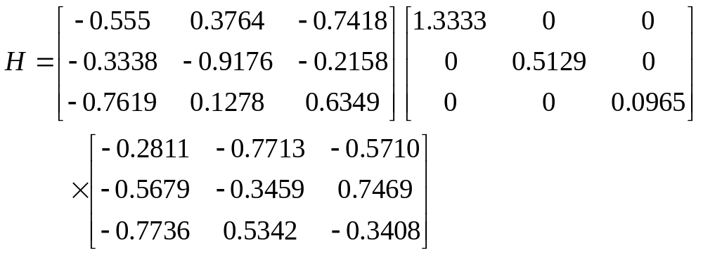
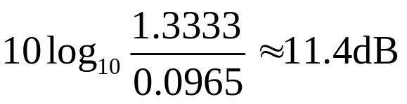
Example
Find the equivalent parallel channel model for a MIMO channel with channel gain matrix
Solution:

Slide 17



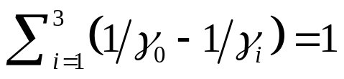



Example
Find the capacity and optimal power allocation for the MIMO channel given in the previous example, assuming and .
Solution: from previous example, we know
According to the definition
First try , then
The 3rd channel is not allocated with power.
Finally , then

Slide 18
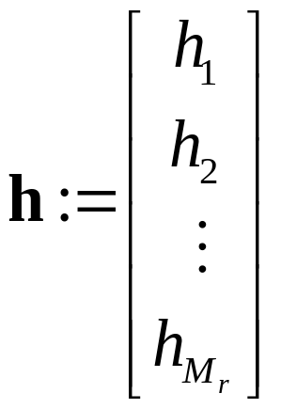


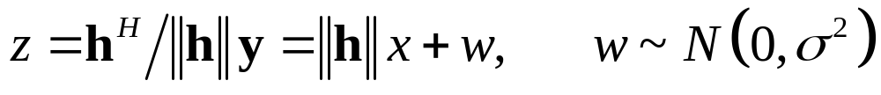
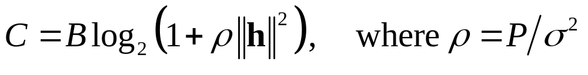
Special case – SIMO
Single input multiple output – SIMO
Coherent combination
The capacity is given by

Slide 19
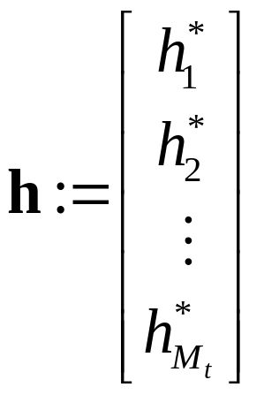
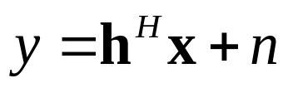

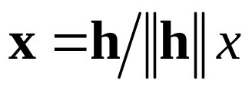
Special case –MISO
Multiple input single output – MISO
Coherent pre-combination
The capacity is given by

Slide 20
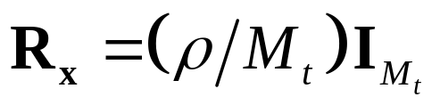
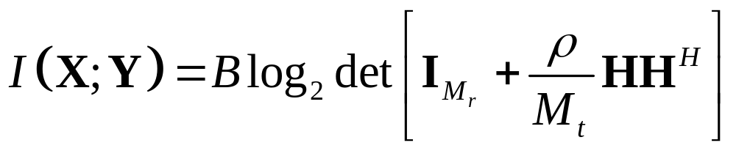


Channel unknown at transmitter
Uniform power allocation
Using SVD,
Outage happens if

Slide 21



Linear growth of capacity
For fixed , under ZMSW (zero mean spatially white) model, the law of large numbers implies that
The capacity approaches to
For large number of antennas and for high SNR,

Slide 22


Fading channels
With CSIT and CSIR
For short-term power constraint, the total TX power constraint is the same for each channel realization
  Water-filling in only space domain
For long-term power constraint,
  Water-filling in both space and time domain

Slide 23



Channel unknown at transmitter
Ergodic capacity
  For ZMSW model, the optimum power allocation is equal power allocation
Capacity with outage

Slide 24

MIMO diversity gain: beamforming
Achieve diversity gain instead of capacity gain
Same symbol in different TX antennas, with different weighted complex scale factors
MIMO beamforming

Slide 25





Beamforming vectors
Only one data stream is transmitted
Precoding at TX, coherent combining at RX
CSIR is required. If further with CSIT, the received SNR is optimized by choosing as the principal left and right singular vectors of the channel matrix .
The resulting SNR is
The resulting capacity is

Slide 26


Diversity vs. Multiplexing
Use antennas for multiplexing or diversity
Diversity/Multiplexing tradeoffs (Zheng/Tse)
Definition of diversity gain and multiplexing gain at high SNR

Slide 27


Diversity and multiplexing trade-off

Slide 28
Space-time modulation and coding
What happens if transmitter does not know the channel?
Transmitting the same symbol simultaneously at the antennas doesn’t work.
Using the antennas one at a time and sending the same symbol over the different antennas is like repetition coding.
More generally, can use any time-diversity code by turning on one antenna at a time.
Space-time codes are designed specifically for the transmit diversity scenario.

Slide 29



General case
A space-time system with M_{t} TX antennas, M_{r} RX antennas, the space-time coding is across T symbol periods.
Channel matrix is not changed over the block.
The input-output relationship over the block is
  Where

Slide 30





ML detection and pairwise error probability
Detection criterion
is the Frobenius norm of matrix .
The pairwise error probability between is
  Where

Slide 31





PEP derivation
Define as the i-th row of ,
Define
We have

Slide 32


PEP derivation
PEP given a particular channel realization is
By averaging over all channel realizations

Slide 33



PEP derivation
When the entries of are i.i.d. , the PEP is upper bounded by
Further, this can be simplified to

Slide 34



Diversity gain and coding gain
In high-SNR regime
The probability of error decreases as
The coding gain is related to , which is decided by the determinant of .

Slide 35



Example – repetition coding
For two transmit antennas case
Coding on one transmitted symbol, but over both space and time domain
Received signal in the 2Tx-1Rx case
In the repetition scheme
  At time 1 At time 2

Slide 36




Repetition coding – detecting
Writing the received signals in a vector
It can be rewritten as
Projecting on the direction

Slide 37



Repetition coding – diversity order checking
TX-RX relationship in repetition coding
To prove whether the full diversity can be achieved, check whether has full rank.

Slide 38


Alamouti scheme – coding and transmitting
For two transmit antennas case
Coding on TWO transmitted symbols, but over both space and time domain
Received signal in the 2Tx-1Rx case
In the Alamouti scheme
  At time 1 At time 2

Slide 39






Alamouti scheme – detecting
Writing the received signals in a vector
It can be rewritten as
Note that symbol is transmitted on .
is on , which is orthogonal to .

Slide 40


Alamouti scheme – detecting
Projecting onto these two directions, we
can obtain the sufficient statistics for detecting and , respectively.
Data rate in Alamouti is as twice as that in the repetition coding scheme.

Slide 41


Alamouti scheme – diversity order checking
TX-RX relationship in Alamouti scheme
To prove whether the full diversity can be achieved, check whether has full rank.

Slide 42

Performance of Alamouti scheme
Slopes denote different diversity gains

Slide 43

Summary
MIMO System Model
  By using SVD, the MIMO channel can be converted to parallel channels.
MIMO Channel Capacity
  With CSIT, water-fill over space (based on short-term power constraint) or space-time (long-term constraint)
  Without CSIT, outage happens.
Diversity and Multiplexing Tradeoff
  MIMO has both diversity and multiplexing potential.
Space-time modulation and coding
  A codeword is a space-time matrix.
  Diversity gain and coding gain can be analyzed.

Slide 44
Homework
10-1, 10-5, 10-7, 10-16, 10-17(a)(b)

